Slide 1
Nuts and Bolts
Tonasket School District
Substitute Training

Slide 2
Arrival
 | Full Day
Elementary | 8:00 AM - 3:30 PM
Middle School | 8:00 AM - 3:30 PM
High School | 8:00 AM - 3:30 PM
Certificated substitute teacher’s duty time begins at 8:00 AM. Please arrive in plenty of time to start work on time.
Check AESOP for starting time for adjusted schedules for some assignments.
Notes:
Find/save school numbers in your cell phone.

Slide 3
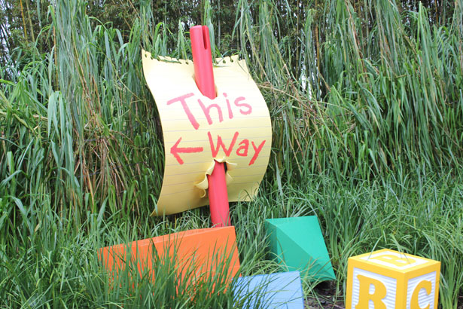
Checking In
When parking, please park in other locations than the front row. Those parking spots are reserved for patrons to the school.
Check in at the office to sign in, pick up keys if needed and an ID badge.
The office staff will review the emergency procedures with you.
Stop in the library to check out a Chromebook.

Slide 4
Before Your Class Arrives
Turn on Lights
Locate
Substitute binder/folder
Teacher work station
Curriculum guides, materials and copies
Emergency procedures flipchart by the entrance
Turn on Technology
Teacher work station computer
Projector (should initiate smart board)
Student computers/tablets, etc.
Smartboard
Lower Chairs

Slide 5
Before the Bell Rings….
There is little time between when you arrive, and when the bell rings. The most important things to do include:
Organize your plan and materials for the time/periods until you have a prep or lunch break.
Plan how to introduce yourself, establish relationships, maintain the learning community, and engage curriculum as efficiently as possible.
Know how you will take attendance and note seating charts.
Identify who to contact with behavior issues and curriculum questions.
*Plan on activities and transitions to take longer than expected.

Slide 6
Substitute Binders
Most teachers have a substitute binder/folder with important information. Items include:
Emergency Information
Student Health Plans, *504 Plans, Crisis Plan, Fire Drill Information, Reporting Suspected Child Abuse/Neglect
Management
Class List, Discipline/Behavior Plan, *Student Behavior/Success Plans, Class Schedule, *Interventionist Schedule, Field Trip Information
Academics
Lesson Plans, Emergency Lesson Plan, Curriculum Guides/Materials/Copies for Lessons

Slide 7
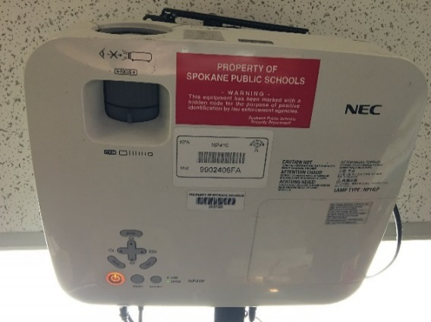
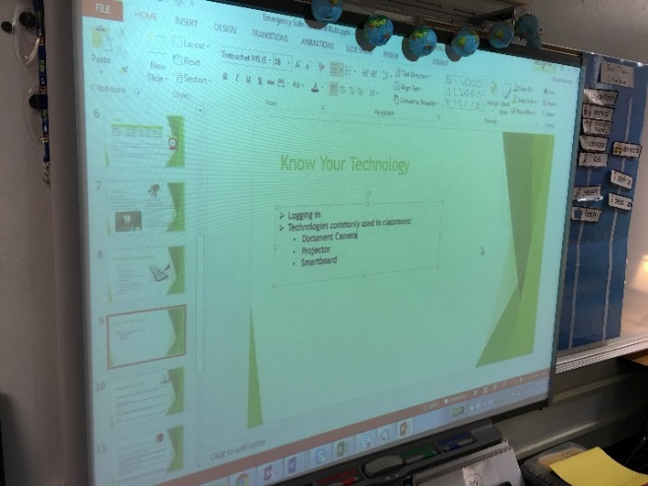
Know Your Technology
Logging in
Chromebook Username and Password
Locate Remotes
Test it before you use it.
Technologies commonly used in classrooms:
Document Camera Projector Smartboard

Slide 8
Smartboards
Smartboards should illuminate once the
teacher workstation computer and the
projector is on. If not, turn it on manually.
Some teachers use Smartboard lessons, or embed much of their daily routines in them.
Smartboards can be used to display any computer based application or curriculum-related video.

Slide 9
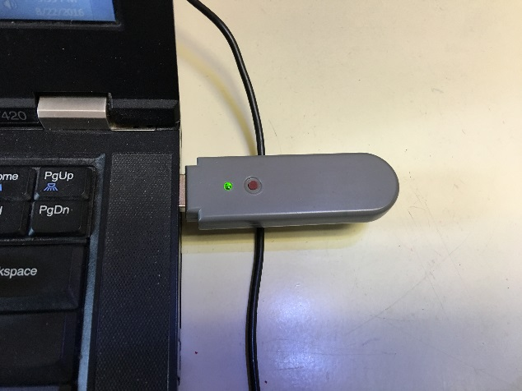
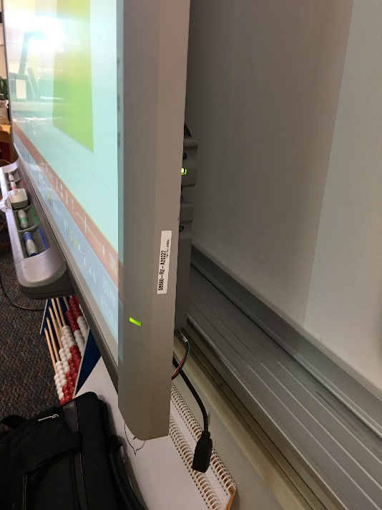
Smartboards
Calibration-some Smartboards need to be calibrated. Calibration aligns touch to the appropriate location on the board. Push both buttons at the base of the marker tray. Then, tap the center of each of the nine targets that appear.
Troubleshooting
Make sure the dongle is in the
computer USB port.
Call the tech office at 9095 for help if needed.

Slide 10
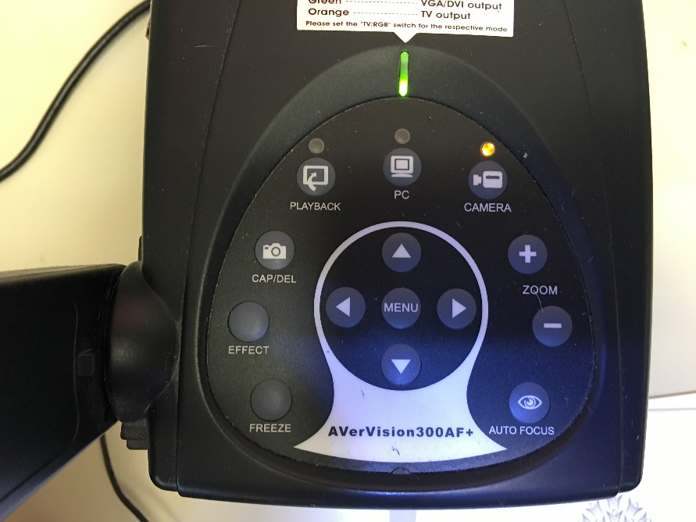
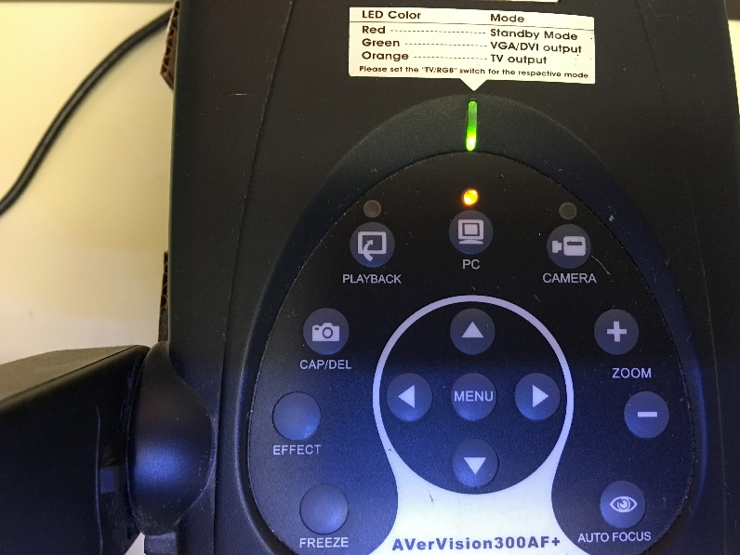
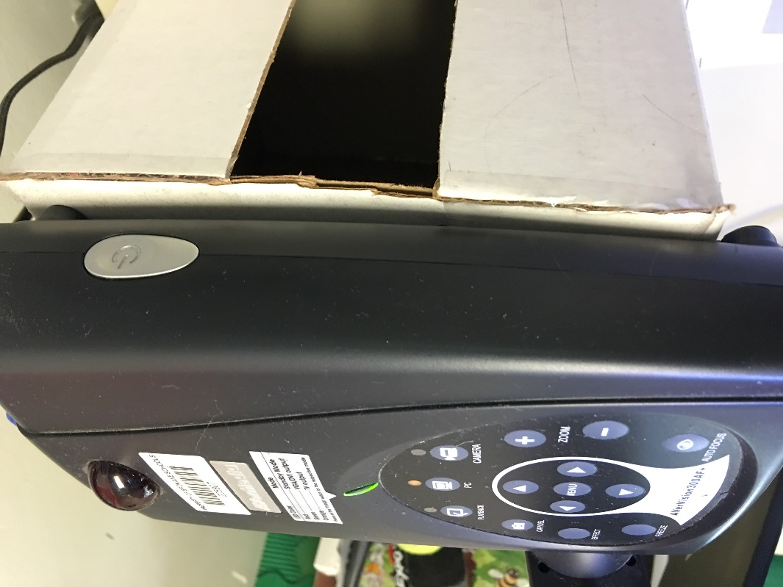
Document Cameras
Document cameras are used by teachers to
project a demonstration or share student work.
Document cameras control the media type.
The “on” button is on the side. Press “camera” to show items. Press “PC” to show computer screen.

Slide 11
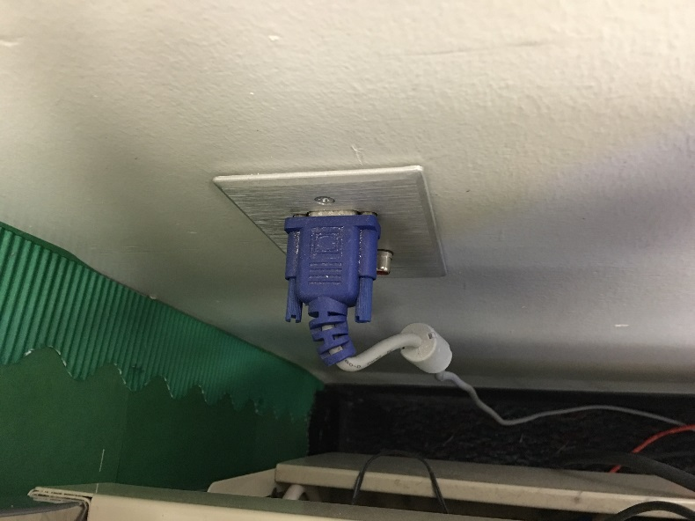
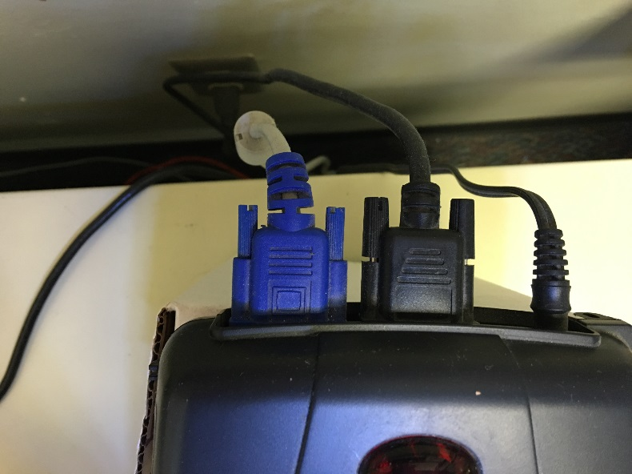
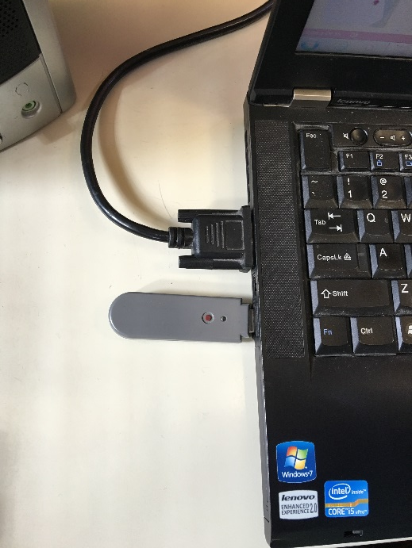
Checking Connections
In the rare circumstance that something
isn’t working, check the connections.
The workstation port should connect to the
Document camera and the document camera
Should connect with the teacher computer.

Slide 12
During Classes
Elementary School…
Students spend the majority of the day in one room. Students are walked to specialists, lunch and lunch recess. Please follow the hallway expectations.
Buildings have a walkie-talkie to check out prior to going to recess in case of a crisis (lockdown, firedrill, etc.)

Slide 13
During Classes
Middle and High School
Daily Schedule
Schedules usually consists of…
Eight class periods 47 minutes long
One “prep” period
A 30-minute lunch break during the middle of your day
Students have three minutes passing time to get to their next class
During the teacher’s prep period you may be utilized in another area.

Slide 14
Finishing the Day
At the End of the Day….
Clean up the room - Put materials away, organize completed student work, put up student chairs (a janitor will vacuum the floor, otherwise clean-up is the teacher’s responsibility)
Shut down and Turn off- Computers, tablets, projectors, document cameras and lights should be shut down and turned off.

Slide 15
Finishing the Day
At the End of the Day….
Leave a note- Information about curriculum completed (especially if something was not completed), student behavior, and things that helped or hindered your success are extremely valuable to the teacher you are replacing.
Leave completed student work and other materials on teacher’s desk, or where binder/materials were located when you arrived.
Chromebook – Return your Chromebook to the library.
Keys – Return your keys to the office.

Slide 16
Substitute Resources
Access training and resources on the Tonasket Public Schools website.
Go to: http://www.tonasket.wednet.edu/for_staff/substitute_resources

Slide 17
Thank You!
Thank you for your service to the Tonasket School District. We value your work and sincerely feel that every substitute is an important part of our educational program.

